Slide 1
PRAIRIE VIEW A&M UNIVERSITY
HEAT RELIEF NETWORK
An AI-Assisted Community Platform for Cooling Centers & Heat Safety
CINS 5338 / 5388 — Software Project Management
Prepared by Team 5 • Checkpoint Presentation
Heat Relief Network • CINS 5338/5388 — Software Project Management
1
Notes:
SPEAKER: D'Andre League
Good morning. I'm D'Andre League, and I'm the Scrum Master for Team 5. With me are James Hawkins, our engineer, Teyana Williams and Ryan Tucker.
What we're presenting today is Heat Relief Network — a platform that helps people find relief during extreme heat, and helps the organizations serving them decide where to send help first. Teyana is going to start us off with the problem we're solving.

Slide 2
Table of Contents
1
Problem Description
10
Version Control
2
Project Vision
11
Use Case Diagram
3
Features & Benefits of the System
12
Initial Product Backlog in Jira
4
Software Stack
13
User Stories Selected for Sprint 1
5
How the Stack Works Together
14
Sprint 1 Stories — AC & Dev Tasks
6
Frontend Architecture Decision
15
Sprint 2 Stories — AC & Dev Tasks
7
Development Environments / Tools
16
Site Directory — Pilot Region Update
8
Hardware Requirements
17
Sprint 2 — Team Assignments
9
System Architecture
18
Conclusion
Heat Relief Network • CINS 5338/5388 — Software Project Management
2
Notes:
SPEAKER: Teyana Williams
Thanks D'Andre. Here's where we're headed. We'll start with the problem and our vision for the system, then Ryan will take you through the software stack, our development environment and hardware needs. D'Andre covers version control, the use case diagram and our product backlog, and James walks through the sprint work itself.
We'll close with where the project stands today and what's next.

Slide 3
Problem Description
Extreme heat is the deadliest weather hazard in the United States, and the people most at risk — older residents, low-income households, and anyone without reliable air conditioning — are often the same people least able to find out where a cooling center or water station is open right now.
Missed
Deadlines & Alerts
Manual, Outdated
Local governments and relief organizations run these sites, but without a shared, real-time system, residents have no reliable way to check what's open, and organizations have no clear, data-driven way to see which neighborhoods need outreach most urgently.
Site Status
No Ranked View
The Heat Relief Network closes both gaps: a resident-facing map and directory of live cooling/water sites and active heat alerts, plus an org-facing priority-matching engine that ranks areas by heat vulnerability so limited outreach resources go where they matter most.
of Highest-Need Areas
Spreadsheet-Driven
Outreach Planning
Heat Relief Network • CINS 5338/5388 — Software Project Management
3
Notes:
SPEAKER: Teyana Williams
Extreme heat kills more Americans every year than any other weather event, and it does not kill evenly. Older adults, low-income households who can't afford to run air conditioning all summer, and people who work outdoors carry most of that risk.
Cities do open cooling centers and water stations. The problem isn't that help doesn't exist — it's that the people who need it most often don't know where it is, whether it's open, or which kind of site actually fits their situation. And the organizations doing outreach are making decisions about where to send limited staff without good data on where need is concentrated.

Slide 4
Project Vision
The vision behind the Heat Relief Network is a single, always-current source of truth for heat relief in a community — one residents can check from any device to find help nearby, and one partner organizations can use to decide where to send it.
For residents, that means a simple map and list of cooling centers and water stations with live open/closed status, plus active heat alerts for their area — no more calling around or guessing which locations are actually staffed today.
For organizations, it means moving from static spreadsheets to a live, ranked view of need: a heat-vulnerability score for every tracked area, combining current heat index with demographic risk factors, and adjusted for how far the nearest open site already is.
“
One map. One ranked list. Every heat-relief resource going where it's needed most.
Product vision statement
Heat Relief Network • CINS 5338/5388 — Software Project Management
4
Notes:
SPEAKER: Teyana Williams
Our vision is a single platform that serves both sides of that gap.
For residents: a map and list of real relief sites near them, searchable by ZIP code, showing what's open right now. For organizations: a ranked view of which neighborhoods need outreach first, and a prioritized queue of residents who've registered for help.
The thread connecting both is that the system should be able to explain its own reasoning — which is something James will come back to when he talks about our scoring engines. I'll hand over to James for features and benefits.

Slide 5
Features and Benefits of the System
1
2
3
Real-Time Site Search & Status
Priority-Area Matching Engine
Distance-Aware Resource Gap
Residents search cooling/water sites near them and see live open/closed status — no more outdated lists.
A transparent, rule-based heat-vulnerability index ranks every area by heat index + demographic risk.
Areas far from any open site score higher, surfacing under-resourced high-need areas automatically.
4
5
6
Org Admin Priority Dashboard
Map-Based Priority Overlay
Built for Real Data, Today
A ranked, filterable table with one-click recompute replaces reading raw JSON or spreadsheets.
A toggleable colored-circle layer shows residents and partners exactly where risk is concentrated.
Ships with a working, documented model now, with a clear upgrade path to live weather + Census data.
Heat Relief Network • CINS 5338/5388 — Software Project Management
5
Notes:
SPEAKER: James Hawkins
Thanks Teyana. I'm James, the engineer on the team.
On the resident side: ZIP code search, a live map with open and closed status, filtering by site type, and a priority overlay that shades the neighborhoods our scoring engine ranks highest. On the organization side: a secured admin portal for updating site status, a priority-areas table, invite-code registration and a resident queue ordered by need.
The benefit underneath all of it is targeting. Outreach budgets are finite. If you can rank neighborhoods by actual vulnerability and adjust for what resources are already nearby, you send help where it changes outcomes instead of spreading it evenly and thin. Ryan is going to take you through what we built it on.

Slide 6
Software Stack
FE
Frontend
React (JSX) bundled with Vite — migrating from the original plain HTML/CSS/JS build. Leaflet.js + OpenStreetMap still provide the interactive map.
BE
Backend
Node.js + Express, serving REST routes: /api/sites, /api/alerts, /api/orgs, /api/risk-areas.
DB
Database
PostgreSQL 17+ with the PostGIS extension for spatial / proximity ("nearest open site") queries.
LB
Core Libraries
pg (node-postgres) for DB access, cors for cross-origin requests, dotenv for config/secrets.
AI
Scoring Engine
Custom rule-based JS heat-vulnerability scorer (riskScore.js) — transparent, no ML runtime dependency yet.
+
Planned Integrations
National Weather Service API, U.S. Census Bureau ACS API, Twilio (SMS), Firebase Cloud Messaging (push).
Heat Relief Network • CINS 5338/5388 — Software Project Management
6
Notes:
SPEAKER: Ryan Tucker
Thanks James. I'm Ryan.
Backend is Node.js with Express serving a REST API. Database is PostgreSQL 17 with PostGIS — that extension is doing real work for us, because the question "what's the nearest open site to this point" is a spatial index lookup rather than something we had to write ourselves.
The front end started as plain HTML, CSS and JavaScript with Leaflet for mapping — deliberately no build step, so nothing slowed us down early. We've since decided to move to React, and I'll cover why on the next slide but one. The scoring engine is custom rule-based JavaScript with no machine learning runtime, which keeps the whole thing lightweight.

Slide 7
How the Stack Works Together
cors-enabled
REST calls
pg
(node-postgres)
Client
Application
Data
Browser — React (JSX) via Vite
+ Leaflet map (OpenStreetMap tiles)
Node.js + Express REST API
sites · alerts · orgs · risk-areas
PostgreSQL 17 + PostGIS
spatial / proximity queries
Scoring Engine
riskScore.js computes a 0–100 vulnerability score from heat index + demographic inputs already in the areas table; recomputeAllRiskScores.js is the batch job that will refresh those inputs once weather/Census integration lands.
Config & Secrets
dotenv loads the database URL (and future API keys) from a local .env file kept out of version control.
Heat Relief Network • CINS 5338/5388 — Software Project Management
7
Notes:
SPEAKER: Ryan Tucker
This is the request path. The browser makes CORS-enabled REST calls to the Express API. Express talks to Postgres through the pg driver. PostGIS handles anything spatial.
The scoring engine sits inside the application tier — riskScore.js computes a vulnerability score from data already in the areas table, and a batch job refreshes those inputs. Configuration and secrets load from a local environment file that's kept out of version control.

Slide 8
SPRINT 3 · VANILLA JS → REACT + VITE
Frontend Architecture Decision
AD
Rebuild the front end in React (JSX), bundled with Vite.
NOT YET BUILT
Proposed by Ryan Tucker and D'Andre League · Backend, database and scoring engines are unaffected.
Why change
What it costs
Component reuse — the site card, status badge and map panel are hand-written three times today across the resident, admin and registration pages.
Declarative state — filters, map markers and the registration flow are manual DOM updates today.
A framework the team wants experience in.
1,863 lines of working front end to port — 3 pages, 5 scripts, 1 stylesheet.
Introduces a build step: start.sh and the desktop launcher both need rework.
Leaflet is the riskiest piece — it manipulates the DOM directly and needs react-leaflet or manual refs.
OK
What this does not change
The Express REST API, the PostgreSQL + PostGIS schema, and both scoring engines (riskScore.js for areas, needScore.js for residents) are untouched — this is a client-side change only. Every /api route keeps its current contract, so the old and new front ends can call the same backend and the migration can proceed one page at a time.
Heat Relief Network • CINS 5338/5388 — Software Project Management
8
Notes:
SPEAKER: Ryan Tucker
This slide is a decision we made mid-project, and we're presenting it rather than quietly swapping the stack.
We're rebuilding the front end in React with JSX, bundled with Vite. The reasons: we're hand-writing the same site card, status badge and map panel three times across the resident, admin and registration pages, and all our state — filters, markers, the registration flow — is manual DOM manipulation right now.
We've also put the cost on the slide honestly. That's about eighteen hundred lines of working front end to port, it introduces a build step that our launcher scripts have to account for, and Leaflet is the risky piece because it manipulates the DOM directly. What doesn't change is the API, the database or the scoring engines — this is a client-side change only, so we can migrate one page at a time against the same backend.

Slide 9
Development Environments / Tools
OS
Local Machine
macOS Terminal + Homebrew (brew install node, postgresql@17, postgis).
JS
Runtime
Node.js (LTS) + npm, bundled with it, for installing packages and running the server.
ED
Editor
VS Code (or equivalent) for backend, frontend, and SQL editing.
WS
Frontend Build
Vite dev server (npm run dev) with hot reload; npm run build emits the static bundle Express serves. Now a real dependency, not just a preview convenience.
AP
API Testing
curl / Postman for exercising REST endpoints during development.
Heat Relief Network • CINS 5338/5388 — Software Project Management
9
Notes:
SPEAKER: Ryan Tucker
Development is on macOS with Homebrew for Node, Postgres 17 and PostGIS. Node and npm are the runtime. VS Code for editing.
One thing that changed with the React decision: the front end used to need nothing more than any static file server — that was a convenience, not a dependency. Now the Vite dev server with hot reload is a real part of the toolchain, and a build step produces the bundle. We test the API directly with curl and Postman.

Slide 10
CONTINUED — ADDITIONAL TOOLS & HARDWARE
Development Environments / Tools
GH
Git & GitHub
Version control and collaboration — github.com/jwhawkins68/heat-relief-network, main / develop / feature-branch / PR workflow.
JR
Jira (Atlassian Cloud)
Scrum board, sprint planning, backlog and story-point tracking — project "HeatSafe" (key SCRUM).
HW
Hardware Requirements
No specialized hardware is required. Any laptop — Mac, Windows, or Linux — capable of running Node.js and a local PostgreSQL instance is sufficient for development. The priority-matching feature currently runs on a lightweight, rule-based scoring function rather than a trained model, so no GPU or elevated compute is needed at this stage.
Heat Relief Network • CINS 5338/5388 — Software Project Management
10
Notes:
SPEAKER: Ryan Tucker
For collaboration: GitHub with a main, develop and feature-branch workflow, everything merged through pull requests. Jira for the Scrum board, sprint planning and story points.
On hardware — and this connects back to the design decision James will expand on — there are no special requirements. Any laptop that runs Node and a local Postgres instance is enough. Because our priority matching is a rule-based function rather than a trained model, there's no GPU and no elevated compute needed. That's not a limitation we're apologizing for; it's a property of the design. Over to D'Andre.

Slide 11
System Architecture
Client Tier
React SPA (Vite) — resident map/list, org admin portal,
resident registration
Leaflet.js + OpenStreetMap
Planned Integrations
• National Weather Service API
• U.S. Census Bureau ACS API
• Twilio (SMS alerts)
• Firebase Cloud Messaging (push)
Application Tier
Express REST routes: sites, alerts, orgs, risk-areas
riskScore.js — heat-vulnerability scoring engine
Data Tier
PostgreSQL 17 + PostGIS
areas · sites · orgs · alerts tables + spatial index
Heat Relief Network • CINS 5338/5388 — Software Project Management
11
Notes:
SPEAKER: D'Andre League
Thanks Ryan. This is the same system in tiers rather than request flow.
Client tier is the React single-page app — the resident map and list, the organization admin portal, and resident registration, all with Leaflet and OpenStreetMap. Application tier is the Express routes plus the scoring engine. Data tier is Postgres with PostGIS, holding areas, sites, organizations and alerts, with spatial indexes.
On the right are the integrations we've scoped but not yet built — the National Weather Service API and the Census Bureau's survey data. Those are Sprint 2.

Slide 12
Version Control
GH
Repository
github.com/jwhawkins68/heat-relief-network
Branching Flow
main
BR
Branch Model
main (stable) ← develop ← feature/* branches, merged via Pull Request
develop
CM
Commit Hygiene
feature/ai-priority-matching
Focused commits with descriptive messages (e.g. "Add AI priority-area matching feature and Scrum backlog docs")
Authentication
Feature branches are merged back into develop via Pull Request once a story's acceptance criteria are met; develop merges into main for tested releases.
AU
HTTPS with a GitHub Personal Access Token (classic, repo scope) — GitHub retired password auth in 2021
TR
Traceability
Jira ↔ GitHub linkage keeps issues tied to the commits/PRs that implemented them
Heat Relief Network • CINS 5338/5388 — Software Project Management
12
Notes:
SPEAKER: D'Andre League
Our repository is on GitHub. We run main as the stable branch, develop as the integration branch, and feature branches off that, merged through pull requests once a story's acceptance criteria are met.
Authentication is over HTTPS with a personal access token. We keep Jira and GitHub linked so every issue traces to the commits and pull request that implemented it — which matters for this course, because it means our process is verifiable rather than just asserted.

Slide 13
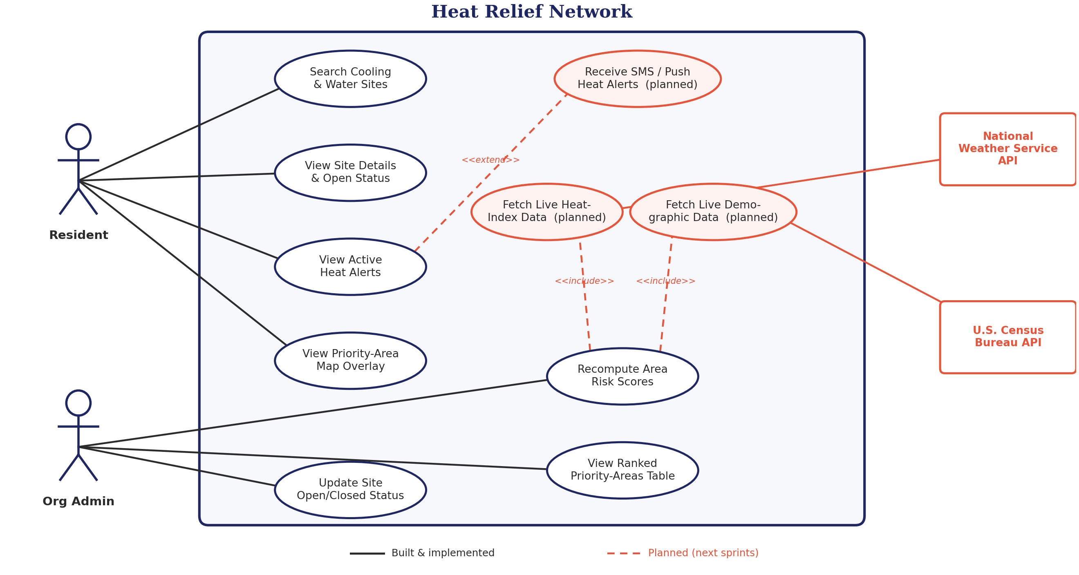
Use Case Diagram
Heat Relief Network • CINS 5338/5388 — Software Project Management
13
Notes:
SPEAKER: D'Andre League
This is the system scope. Two primary actors: the resident searching for relief, and the organization administrator managing sites and outreach.
The resident finds sites, filters them, views the priority overlay and — with an invite — registers for priority access. The administrator updates site status, reviews ranked priority areas, issues invite codes and works the resident queue. The scoring engine sits behind both, because it feeds the resident's overlay and the administrator's ranking from the same computation.

Slide 14
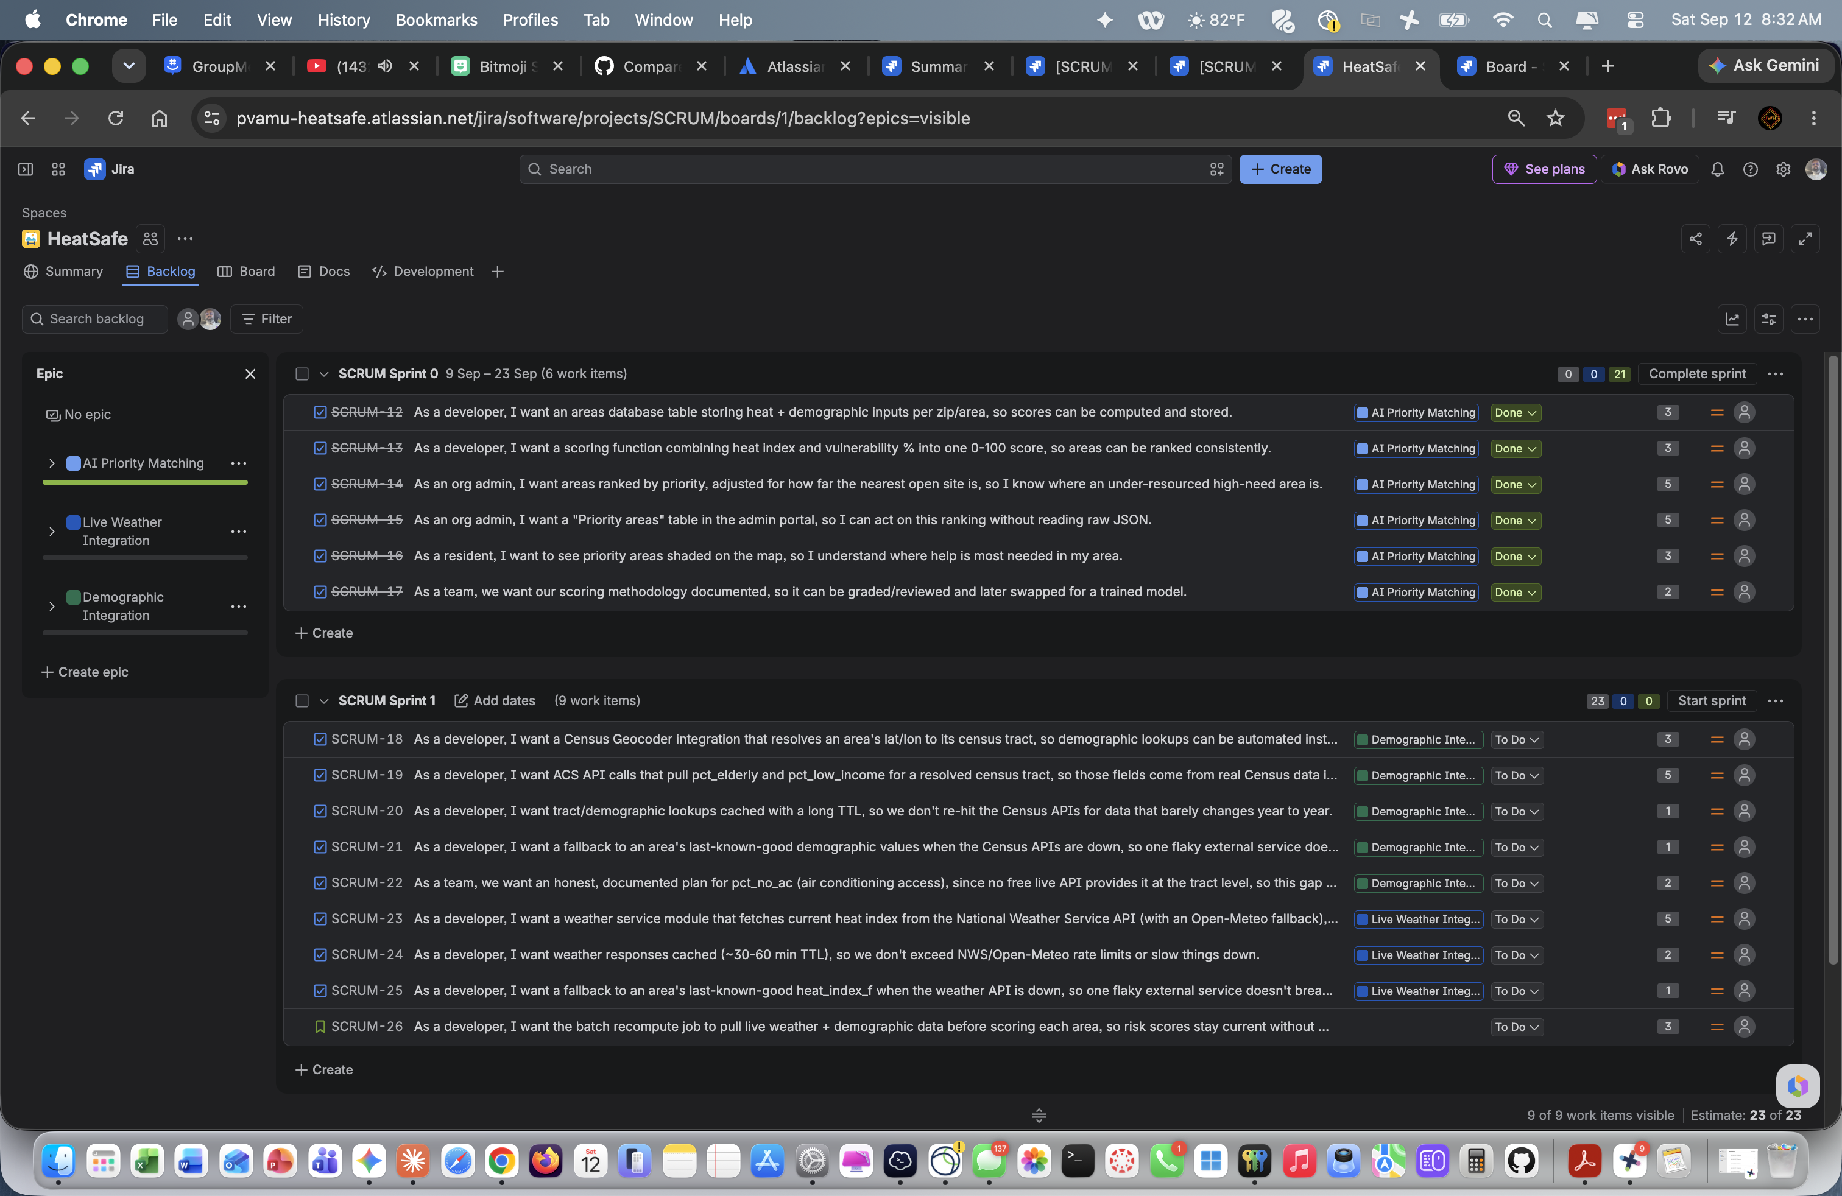
Initial Product Backlog in Jira
4 Epics
• AI Priority Matching (Done)
• Live Weather Integration
• Demographic Integration
• Priority Access & Resident Matching
Plus 3 items outside a single epic: the cross-cutting recompute story (SCRUM-26), the Texas relief-site story (SCRUM-27) and ZIP search (SCRUM-28).
30 total
backlog items
story-pointed and tracked end-to-end in Jira (HeatSafe / SCRUM project)
Heat Relief Network • CINS 5338/5388 — Software Project Management
14
Notes:
SPEAKER: D'Andre League
This is our full product backlog — thirty items across four epics, all written as formal user stories, all story-pointed, all tracked in Jira.
The four epics are AI Priority Matching, which is complete; Live Weather Integration; Demographic Integration; and Priority Access and Resident Matching. Three items sit outside any single epic — the cross-cutting recompute job, the Texas site directory story and ZIP code search.

Slide 15
User Stories Selected for Sprint 1
Sprint 1
SCRUM-12 → SCRUM-17
6 stories in the AI Priority Matching epic: the areas table, the vulnerability scoring function, priority ranking with nearest-open-site, the admin priority table, the resident map overlay, and the documented scoring methodology.
21 points
delivered
Acceptance criteria and development tasks for all six follow on the next slides. Sprint 2 (SCRUM-18 – 26, 23 pts) is scoped and ready to start.
Heat Relief Network • CINS 5338/5388 — Software Project Management
15
Notes:
SPEAKER: D'Andre League
For Sprint 1 we selected the AI Priority Matching epic — six stories, twenty-one points. That was a deliberate sequencing decision: the scoring engine is what makes this project more than a directory of addresses, so we wanted it built and proven first rather than saved for last.
All six are Done and merged. The next six slides walk through each one with its acceptance criteria and development tasks. James built these, so I'll hand over to him.

Slide 16
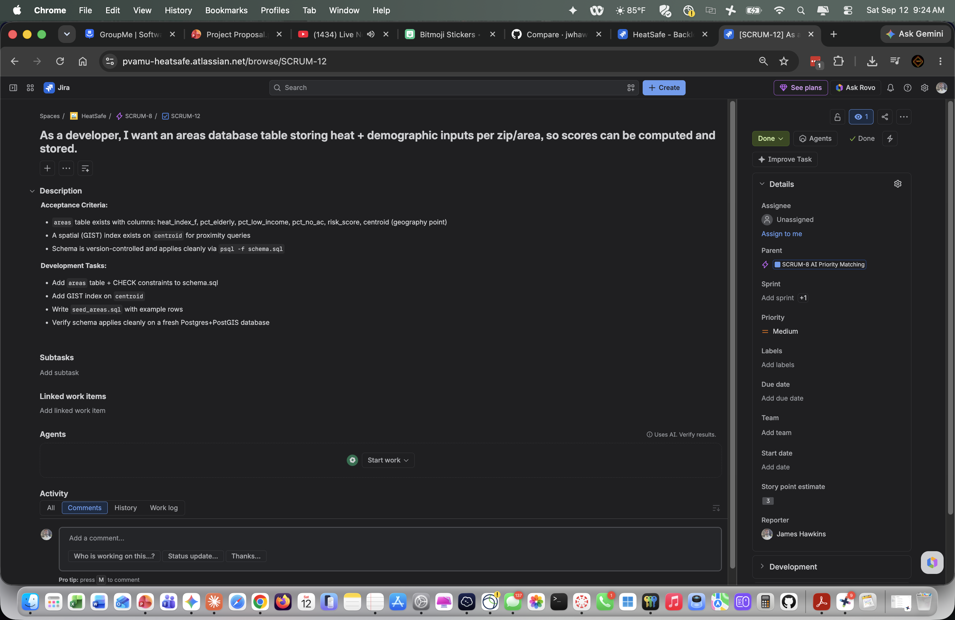
SCRUM-12 · AI PRIORITY MATCHING · COMPLETED
3
Sprint 1 Story 1 of 6
pts
Heat Relief Network • CINS 5338/5388 — Software Project Management
16
Notes:
SPEAKER: James Hawkins
Thanks D'Andre. Story one: as a developer, I want an areas database table storing heat and demographic inputs per area, so scores can be computed and stored. Three points.
Acceptance criteria was that the table exists with the right columns, has a spatial index for proximity queries, and is version-controlled so it applies cleanly to a fresh database. This is the foundation — nothing else in the epic works without it.

Slide 17
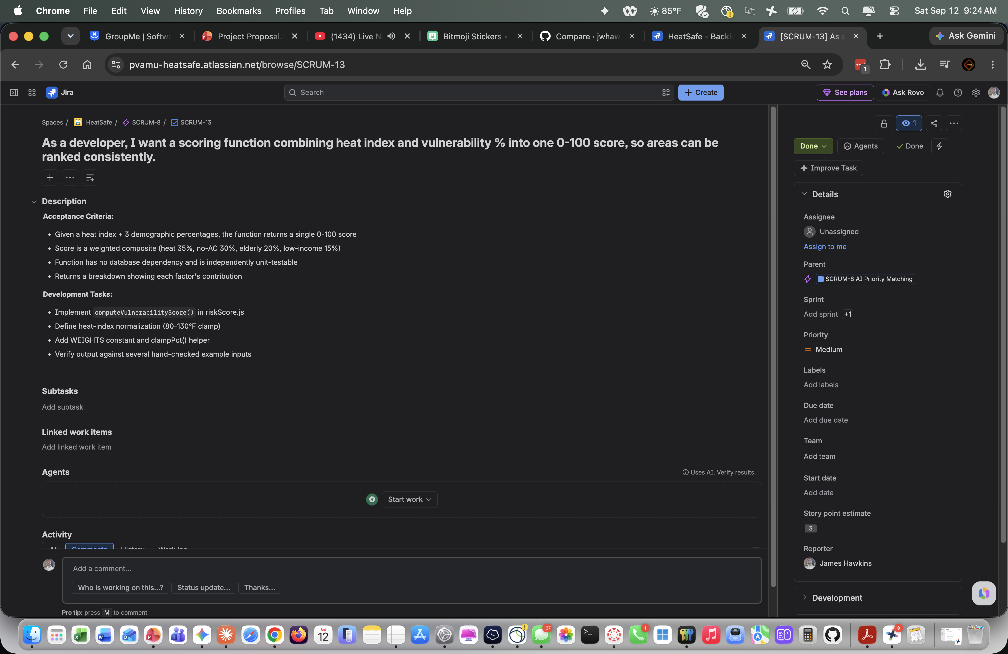
SCRUM-13 · AI PRIORITY MATCHING · COMPLETED
3
Sprint 1 Story 2 of 6
pts
Heat Relief Network • CINS 5338/5388 — Software Project Management
17
Notes:
SPEAKER: James Hawkins
Story two: the scoring function itself. Three points.
This combines heat index and vulnerability percentages into a single zero-to-one-hundred score. Heat index is thirty-five percent of the weight, lack of air conditioning thirty, elderly population twenty, low income fifteen. The acceptance criterion was that it returns a consistent, reproducible score — and critically, a breakdown showing how much each factor contributed, so the number can be explained rather than just trusted.

Slide 18
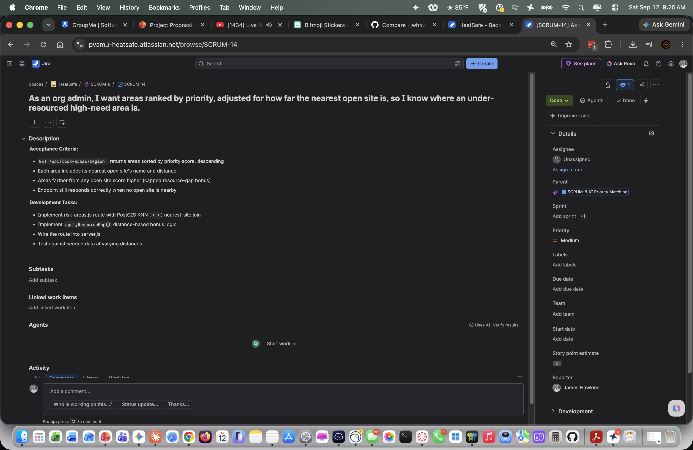
SCRUM-14 · AI PRIORITY MATCHING · COMPLETED
5
Sprint 1 Story 3 of 6
pts
Heat Relief Network • CINS 5338/5388 — Software Project Management
18
Notes:
SPEAKER: James Hawkins
Story three, five points: ranking areas by priority, adjusted for how far the nearest open site is.
This is the piece that makes the ranking useful rather than just descriptive. Two neighborhoods can be equally vulnerable, but if one has a cooling center three blocks away and the other has nothing within ten miles, they are not equally urgent. This is where PostGIS earns its place — the nearest-open-site lookup is a spatial query against the index.

Slide 19

SCRUM-15 · AI PRIORITY MATCHING · COMPLETED
5
Sprint 1 Story 4 of 6
pts
Heat Relief Network • CINS 5338/5388 — Software Project Management
19
Notes:
SPEAKER: James Hawkins
Story four, five points: as an organization administrator, I want a priority areas table in the admin portal, so I can act on this ranking without reading raw JSON.
The acceptance criteria were a ranked table showing area, priority band, heat index and nearest open site with distance; a region filter; and a recompute button that updates a single row without reloading the page. This is the difference between an API that produces a score and a tool somebody can actually use on a Tuesday morning.

Slide 20
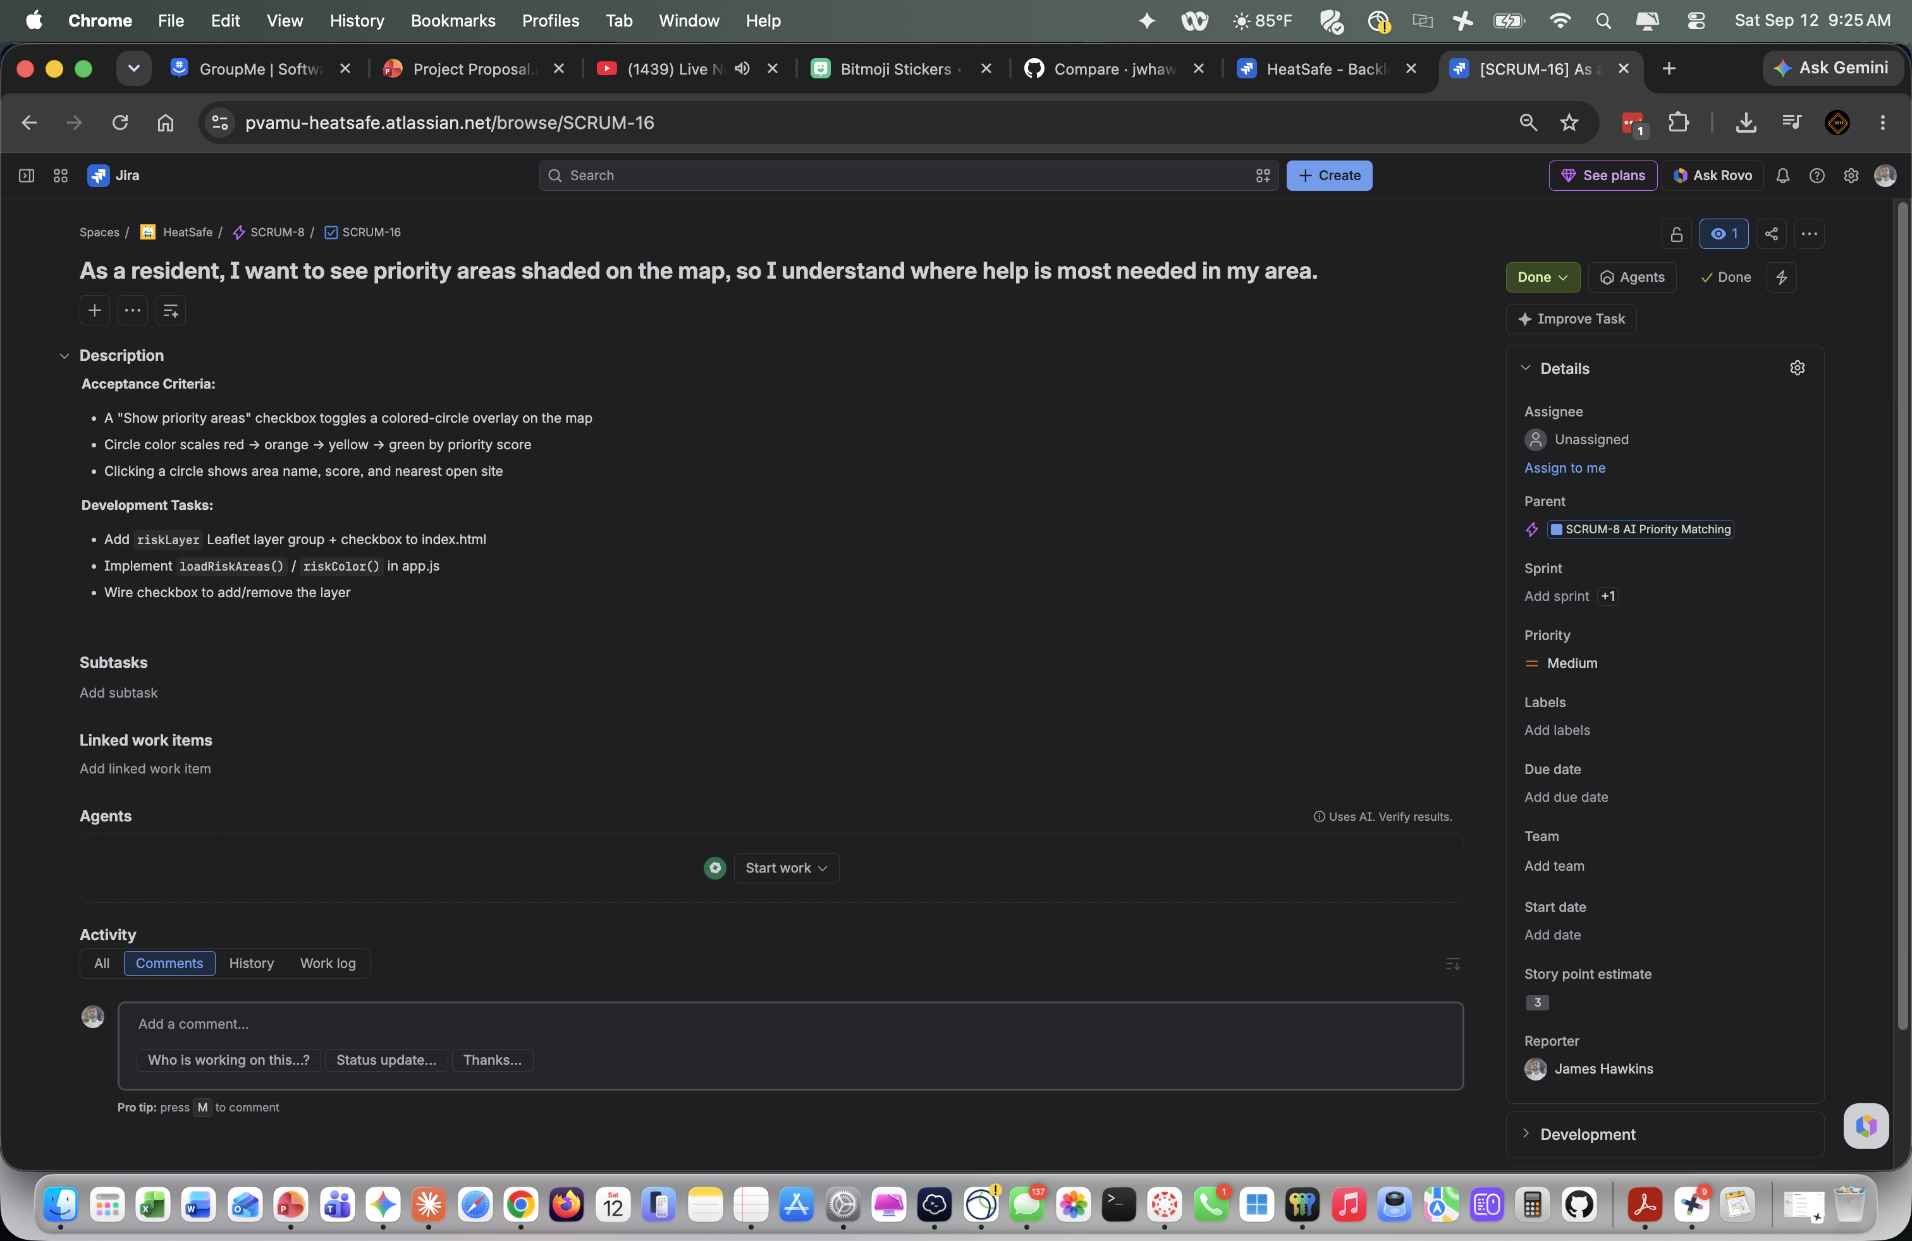
SCRUM-16 · AI PRIORITY MATCHING · COMPLETED
3
Sprint 1 Story 5 of 6
pts
Heat Relief Network • CINS 5338/5388 — Software Project Management
20
Notes:
SPEAKER: James Hawkins
Story five, three points: as a resident, I want to see priority areas shaded on the map, so I understand where help is most needed in my area.
A checkbox toggles a colored overlay, with circle color scaling from red through orange and yellow to green by priority score. Clicking a circle shows the area name, its score and the nearest open site. The same computation drives this and the admin table — residents and organizations see one consistent picture.

Slide 21

SCRUM-17 · AI PRIORITY MATCHING · COMPLETED
2
Sprint 1 Story 6 of 6
pts
Heat Relief Network • CINS 5338/5388 — Software Project Management
21
Notes:
SPEAKER: James Hawkins
Story six, two points: as a team, we want our scoring methodology documented, so it can be reviewed and later swapped for a trained model.
I want to spend a moment on why this was a story with points rather than an afterthought. This function influences who gets prioritized access to a life-safety resource. If we can't explain the weights and defend where they came from, we shouldn't be shipping it. The documentation names every weight, its public-health source, the known limitations, and exactly what would be required to replace it responsibly with a trained model — labeled outcome data, bias testing across protected groups, and a human override.

Slide 22
SCRUM-11 · 1 OF 2 · ACCEPTANCE CRITERIA & DEVELOPMENT TASKS
Sprint 2 Stories — Demographic Integration
3
SCRUM-18
5
SCRUM-19
1
SCRUM-20
pts
pts
pts
As a developer, I want a Census Geocoder integration that resolves an area's lat/lon to its census tract, so demographic lookups can be automated instead of manually matched.
As a developer, I want ACS API calls that pull pct_elderly and pct_low_income for a resolved census tract, so those fields come from real Census data instead of hand-entered guesses.
As a developer, I want tract/demographic lookups cached with a long TTL, so we don't re-hit the Census APIs for data that barely changes year to year.
ACCEPTANCE CRITERIA
ACCEPTANCE CRITERIA
ACCEPTANCE CRITERIA
Given an area's centroid, the correct census tract ID is returned and stored on the area record.
demographicsService.js returns both percentages for a given tract ID, sourced from ACS tables B01001 (age) and S1701 (poverty).
A tract's resolved ID and its ACS figures are reused from cache across recompute runs within the TTL window.
DEVELOPMENT TASKS
DEVELOPMENT TASKS
DEVELOPMENT TASKS
Implement geocodeToTract(lat, lon) in a new demographicsService.js using the Census Geocoder API
Add a census_tract_id column to the areas table (schema.sql migration)
Wire the geocode call into recomputeAllRiskScores.js so each area's tract is resolved and stored
Handle a geocoder timeout / no-match gracefully (log and skip that area's update)
Implement fetchAcsDemographics(tractId) calling the Census ACS 5-Year API
Parse B01001 for pct_elderly and S1701 for pct_low_income
Update areas.pct_elderly / pct_low_income from the fetched values in the recompute job
Add unit tests using a mocked ACS API response
Add a lightweight cache layer keyed by area/tract with a long TTL (e.g. 90 days)
Wire geocodeToTract() and fetchAcsDemographics() to check/populate the cache first
Add a cache-bypass flag for manual recompute testing
Heat Relief Network • CINS 5338/5388 — Software Project Management
22
Notes:
SPEAKER: James Hawkins
Now Sprint 2, which is scoped and ready to start. The goal of this epic is to replace hand-seeded demographic numbers with live Census data.
SCRUM-18, three points, resolves an area's coordinates to its census tract through the Census geocoder. SCRUM-19, five points, pulls the elderly and low-income percentages for that tract from the American Community Survey. SCRUM-20 caches those lookups, because tract demographics barely change year to year and there's no reason to re-hit the API on every run.

Slide 23
SCRUM-11 · 2 OF 2 · ACCEPTANCE CRITERIA & DEVELOPMENT TASKS
Sprint 2 Stories — Demographic Integration
1
SCRUM-21
2
SCRUM-22
pts
pts
As a developer, I want a fallback to an area's last-known-good demographic values when the Census APIs are down, so one flaky external service doesn't break scoring entirely.
As a team, we want an honest, documented plan for pct_no_ac (air conditioning access), since no free live API provides it at the tract level, so this gap doesn't quietly become fabricated data.
ACCEPTANCE CRITERIA
ACCEPTANCE CRITERIA
On fetch failure, the area keeps its previous demographic values and logs the failure rather than erroring out.
Doc explains the chosen approach for pct_no_ac (e.g. ingesting the CDC Heat & Health Index dataset, or a manually-maintained field) and its refresh cadence.
DEVELOPMENT TASKS
DEVELOPMENT TASKS
Wrap demographicsService calls in try/catch inside recomputeAllRiskScores.js
On failure, retain existing pct_elderly / pct_low_income and log a warning with the area id + error
Ensure one area's failure doesn't abort the batch job for the remaining areas
Research the CDC Heat & Health Index tract-level AC-access data as a candidate source
Write a README / TOOLS.md section documenting the chosen approach and refresh cadence
If no free live source is adopted, document the manual-entry process and who owns updating it
Heat Relief Network • CINS 5338/5388 — Software Project Management
23
Notes:
SPEAKER: James Hawkins
SCRUM-21 is a fallback to last-known-good values when the Census API is down, so one flaky external service doesn't break scoring for every area.
SCRUM-22 is the honest one. There is no free live API that provides air-conditioning access at the tract level — and that's thirty percent of our vulnerability weight. Rather than quietly fabricating a number, this story requires us to document the approach we choose and its refresh cadence. A documented gap is a defensible project; an undocumented guess isn't.

Slide 24
SCRUM-10 · ACCEPTANCE CRITERIA & DEVELOPMENT TASKS
Sprint 2 Stories — Live Weather Integration
5
SCRUM-23
2
SCRUM-24
1
SCRUM-25
pts
pts
pts
As a developer, I want a weather service module that fetches current heat index from the National Weather Service API (with an Open-Meteo fallback), so heat_index_f reflects real conditions instead of hand-typed estimates.
As a developer, I want weather responses cached (~30-60 min TTL), so we don't exceed NWS/Open-Meteo rate limits or slow things down.
As a developer, I want a fallback to an area's last-known-good heat_index_f when the weather API is down, so one flaky external service doesn't break scoring entirely.
ACCEPTANCE CRITERIA
ACCEPTANCE CRITERIA
ACCEPTANCE CRITERIA
weatherService.js exports a function returning heat index for a given lat/lon; tries the NWS two-step lookup first, falls back to Open-Meteo on failure or timeout.
Repeated calls for the same area within the TTL window reuse the cached value instead of re-fetching.
On fetch failure, the area keeps its previous heat_index_f and logs the failure rather than erroring out.
DEVELOPMENT TASKS
DEVELOPMENT TASKS
DEVELOPMENT TASKS
Implement getHeatIndex(lat, lon) in a new weatherService.js
Call the NWS /points/{lat},{lon} to forecast endpoint two-step lookup first
On failure or timeout, fall back to Open-Meteo's forecast API
Send the NWS_USER_AGENT_EMAIL contact header per NWS usage policy
Add an in-memory or DB-backed cache keyed by area / lat-lon with a 30-60 minute TTL
Wire getHeatIndex() to check/populate the cache before calling NWS or Open-Meteo
Add a config constant for the TTL so it is easy to tune
Wrap weatherService calls in try/catch inside recomputeAllRiskScores.js
On failure, retain the area's existing heat_index_f and log a warning with the area id + error
Ensure one area's failure doesn't abort the batch job for the remaining areas
Heat Relief Network • CINS 5338/5388 — Software Project Management
24
Notes:
SPEAKER: James Hawkins
The weather epic replaces hand-typed heat index with live readings. SCRUM-23, five points, is the service module — it calls the National Weather Service API first and falls back to Open-Meteo on failure or timeout. Ryan owns this one and has it in progress.
SCRUM-24 caches responses on a thirty-to-sixty-minute window so we stay inside rate limits. SCRUM-25 is the same last-known-good fallback pattern as the demographic side — deliberately consistent, so the failure behavior is the same wherever an external service is involved.

Slide 25
TIES BOTH EPICS TOGETHER · ACCEPTANCE CRITERIA & DEVELOPMENT TASKS
Sprint 2 Stories — Cross-Cutting
3
SCRUM-26
Sprint 2 at a glance
pts
9 user stories · 23 story points
Demographic Integration (SCRUM-18 – 22) 12 pts
Live Weather Integration (SCRUM-23 – 25) 8 pts
Cross-cutting recompute (SCRUM-26) 3 pts
As a developer, I want the batch recompute job to pull live weather + demographic data before scoring each area, so risk scores stay current without manual re-seeding.
ACCEPTANCE CRITERIA
recomputeAllRiskScores.js calls both services per area, updates the row, then scores it; one area's failure does not abort the whole batch run.
Why this story is separate
SCRUM-26 is the only Sprint 2 story that touches both epics, so it deliberately has no parent. Weather and demographics were split so two developers could each own an epic without editing the same files; the recompute job is where the two finally meet. It is scheduled to start once either epic lands, and may be reassigned at standup to whoever finishes first.
DEVELOPMENT TASKS
Update recomputeAllRiskScores.js to call weatherService + demographicsService per area before computeVulnerabilityScore()
Persist updated heat_index_f / pct_elderly / pct_low_income / pct_no_ac alongside the new risk_score
Wrap each area's processing in try/catch so one failure logs and continues rather than aborting
Add a summary log line (areas processed / succeeded / failed) at the end of the run
Heat Relief Network • CINS 5338/5388 — Software Project Management
25
Notes:
SPEAKER: James Hawkins
SCRUM-26 is the story that ties both epics together: the batch job that pulls live weather and live demographics before scoring each area.
It's deliberately parented to neither epic. We split weather and demographics so two developers could each own one without editing the same files — the recompute job is where they finally meet. It's scheduled to start once either epic lands, and may be reassigned at standup to whoever finishes first.

Slide 26
NEW SINCE BACKLOG WAS FIRST DRAFTED
Site Directory — Pilot Region Update
GAP
The resident site-search view had no cooling/water “site” records to show — only the priority-area overlay had real data.
FIXED — SCRUM-27 (IN REVIEW)
11 real, publicly documented relief sites seeded across the Texas pilot region.
Sites are real, verified locations — public library branches serving as official cooling centers, city recreation centers, and parks — checked against each city's library/parks department site and the Census Bureau geocoder.
Pilot region moved from an initial Los Angeles placeholder to statewide Texas, matching the project's own location (Houston) for real-world accuracy.
Site types map to the existing schema: cooling_center, water_station, shade, splash_pad. Community/rec centers are seeded as cooling_center — no separate type exists in the DB's CHECK constraint.
Status is deliberately seeded as “unknown” — real open/closed status comes from an org admin via the app's own “Update Site Open/Closed Status” flow, not from guessing it.
SITES BY CITY
Houston
4 sites
Dallas
2 sites
Fort Worth
1 site
Austin
2 sites
San Antonio
2 sites
Pending: local seed run (seed_areas.sql + seed_sites.sql) and PR merge into develop before map/admin screenshots reflect the new data.
Heat Relief Network • CINS 5338/5388 — Software Project Management
26
Notes:
SPEAKER: James Hawkins
This slide is where concept became real, and I want to be straightforward about it.
We originally built against placeholder neighborhoods in Los Angeles County, because you cannot develop spatial search against an empty database. Our team is in Texas, so we moved the pilot region and replaced that placeholder data with five real neighborhoods — Sunnyside in Harris County, South Dallas and Fair Park in Dallas County, the West Side of San Antonio in Bexar County, Near Southeast Fort Worth in Tarrant County, and East Austin in Travis County — plus eleven real relief sites verified against city library and parks department records.
The pivot also exposed a real defect. When we swapped the data we discovered no relief sites had ever been seeded at all — the resident search had been returning an empty list for the whole sprint, and nobody caught it because we'd been testing the area scoring, not the site directory. We closed it as its own backlog item. Moving from placeholder data to real data isn't a cosmetic change, and this is the evidence.
One more deliberate choice: every seeded site loads with status unknown, not open. Real status gets set by an organization that actually knows. We'd rather show an honest unknown than send someone to a locked door in a hundred and nine degrees. Back to D'Andre.

Slide 27
BALANCED BY STORY POINTS & SCRUM ROLE
Sprint 2 — Team Assignments
ASSIGNEE
ROLE
POINTS
STORIES
JH
James Hawkins
Engineer
SCRUM-18–22 — Demographic Integration (full epic)
12 pts
RT
Ryan Tucker
Developer
SCRUM-23 — Weather API module
5 pts
TW
Teyana Williams
Developer
SCRUM-25, SCRUM-26 — Weather fallback + cross-cutting recompute
4 pts
DL
D'Andre League (dleague)
Scrum Master
SCRUM-24 — Weather response caching
2 pts
Scrum Master (dleague) intentionally carries the lightest load — his primary Sprint 2 responsibility is facilitation, unblocking, and sprint ceremonies, not reflected in story points.
James (engineer) owns the entire Demographic Integration epic solo for continuity — one person's context across all 5 related stories avoids merge conflicts within the epic.
Ryan and Teyana split the Live Weather epic plus the cross-cutting recompute story, balanced within 1 point of each other (5 vs. 4).
SCRUM-26 depends on both epics finishing — if the larger Demographic epic runs long, the team may reassign it at standup.
Heat Relief Network • CINS 5338/5388 — Software Project Management
27
Notes:
SPEAKER: D'Andre League
Thanks James. Here's how Sprint 2's twenty-three points are distributed.
James has the Demographic Integration epic at twelve points — we kept a whole epic with one owner for continuity. Ryan has the weather service module at five. Teyana has the weather fallback and the cross-cutting recompute job at four. I'm carrying two points.
That's intentional. As Scrum Master my Sprint 2 job is facilitation and unblocking, and that work doesn't show up in story points. The two developers are balanced within a point of each other.

Slide 28
Conclusion
The Heat Relief Network already runs end-to-end: a live Express + PostGIS backend, a working resident map and org portal, and a documented, rule-based priority-matching engine that ranks neighborhoods by heat vulnerability today.
Sprint 2 is scoped and ready — Live Weather Integration and Demographic Integration will replace manually-seeded inputs with real NWS and Census data, making the priority ranking fully live without changing its transparent, explainable design.
Our Jira board and GitHub history give a verifiable record of both the process and the product — this is Agile/Scrum practiced on a real, shipping feature, not just a paper exercise.
3
Epics tracked
27
backlog items
21 / 44
points shipped
Heat Relief Network • CINS 5338/5388 — Software Project Management
28
Notes:
SPEAKER: D'Andre League
To close: the Heat Relief Network runs end to end today. A live Express and PostGIS backend, a working resident map and organization portal, and a documented rule-based priority engine ranking real Texas neighborhoods by heat vulnerability.
Sprint 2 is scoped and assigned — live weather and live Census data will replace our hand-seeded inputs without changing the transparent, explainable design underneath.
Our Jira board and GitHub history give a verifiable record of both the process and the product. This is Agile and Scrum practiced on a real, shipping feature — not a paper exercise.

Slide 29
THANK YOU
F O R Y O U R A T T E N T I O N
Heat Relief Network • Team 5 • CINS 5338/5388
Notes:
SPEAKER: D'Andre League
Thank you. On behalf of Team 5 — D'Andre League, James Hawkins, Teyana Williams and Ryan Tucker — we're happy to take questions.

